Slide 2
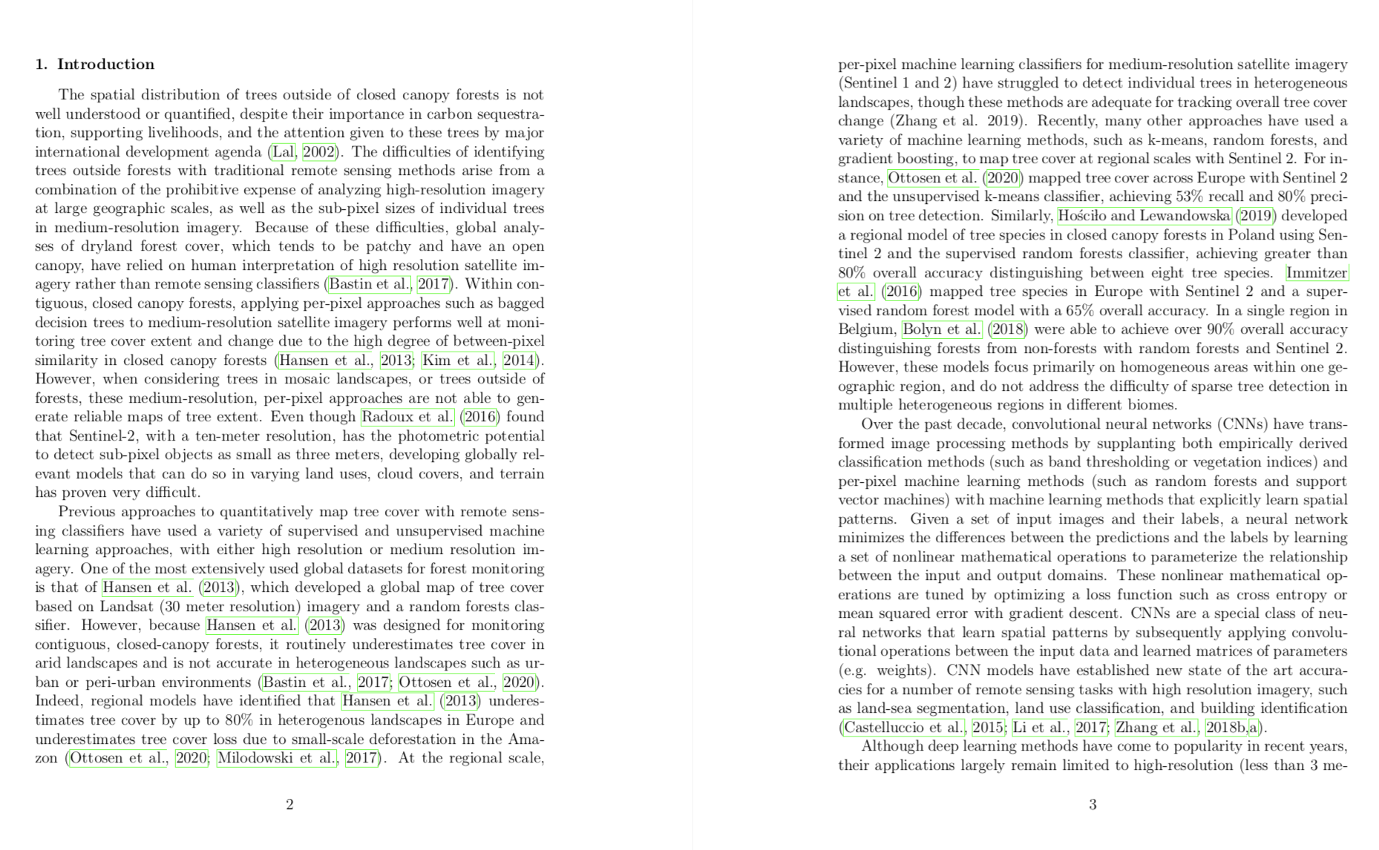

Slide 3
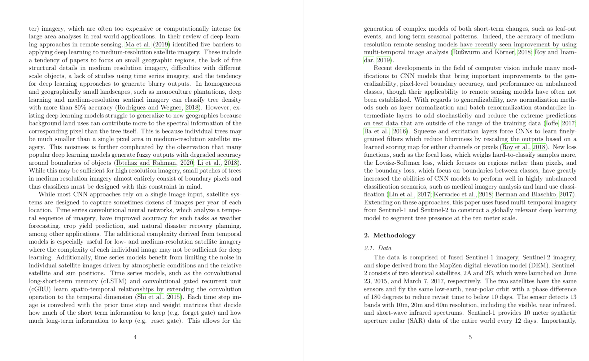

Slide 4
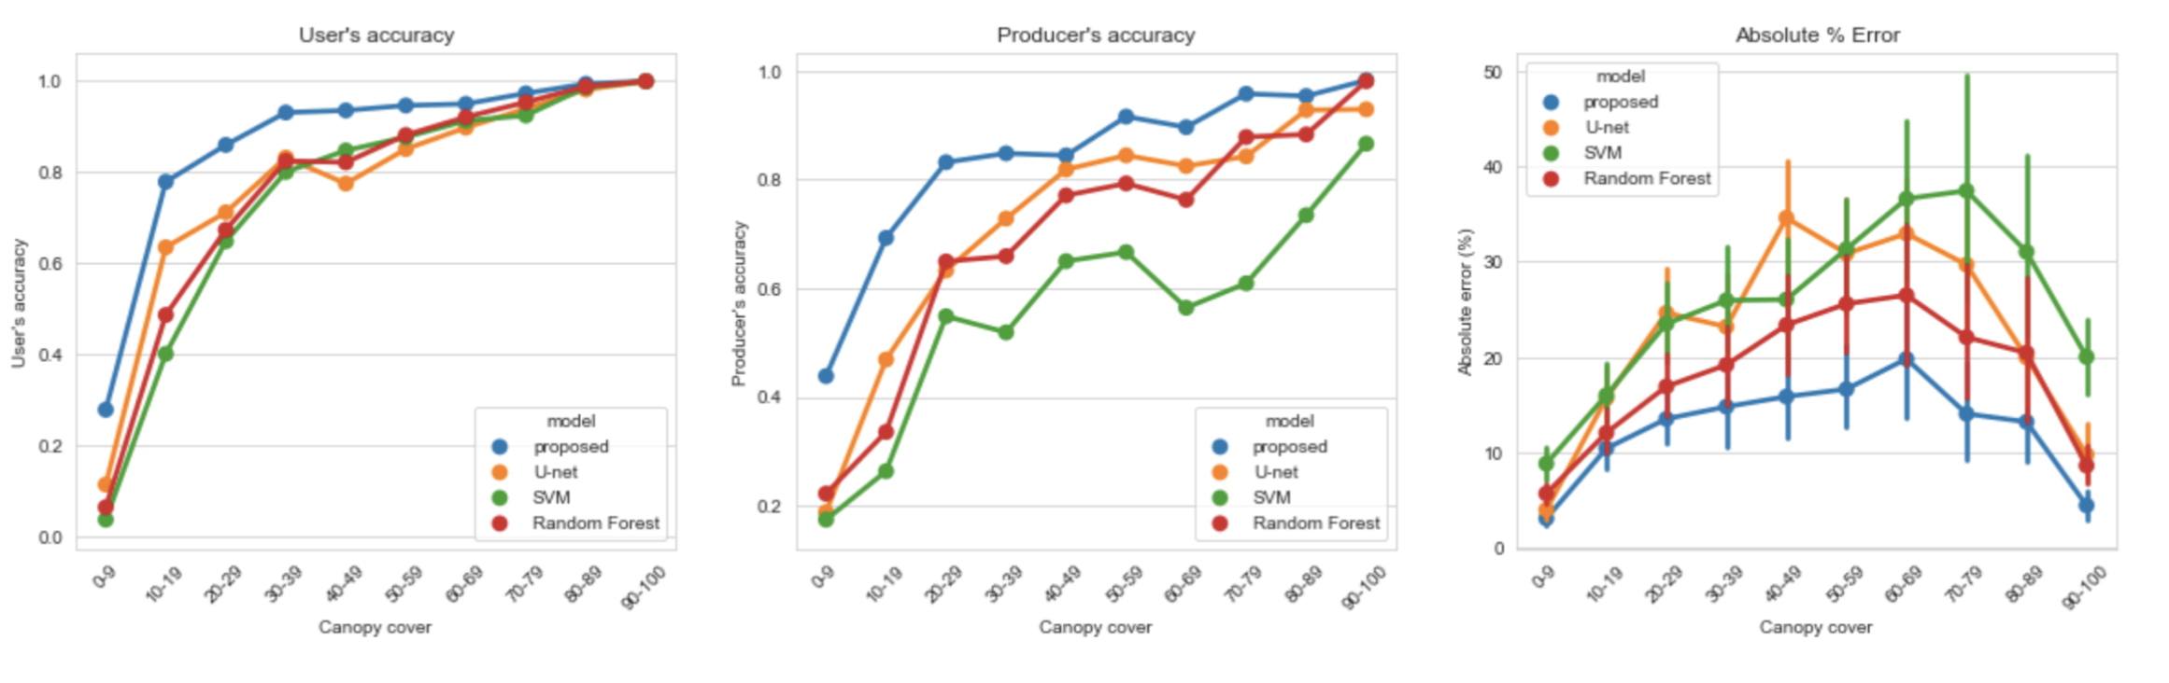

Slide 5
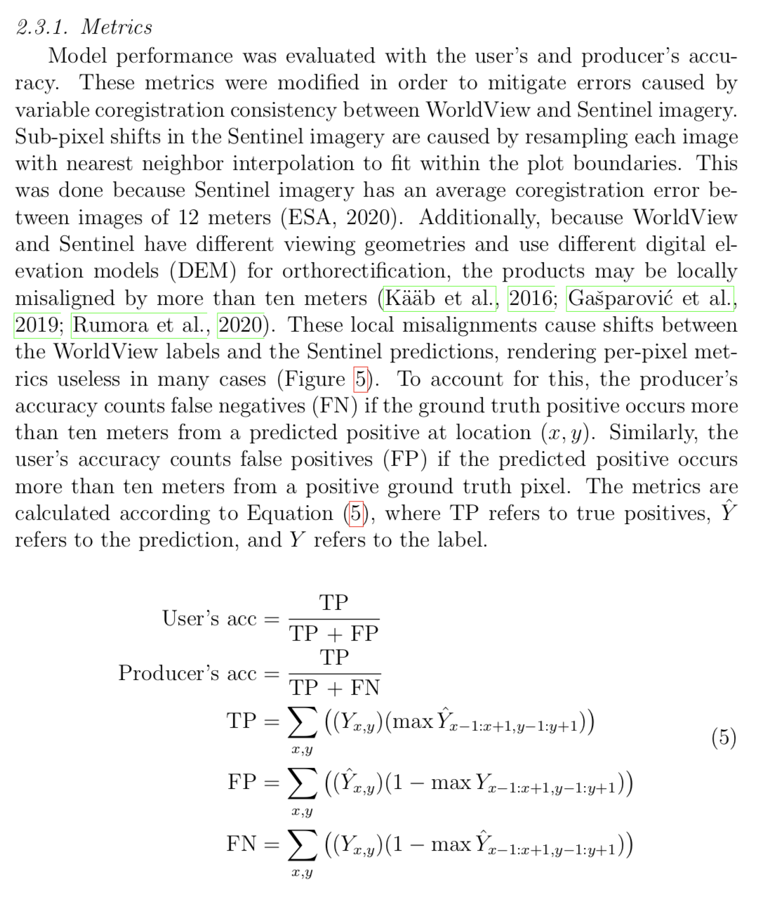
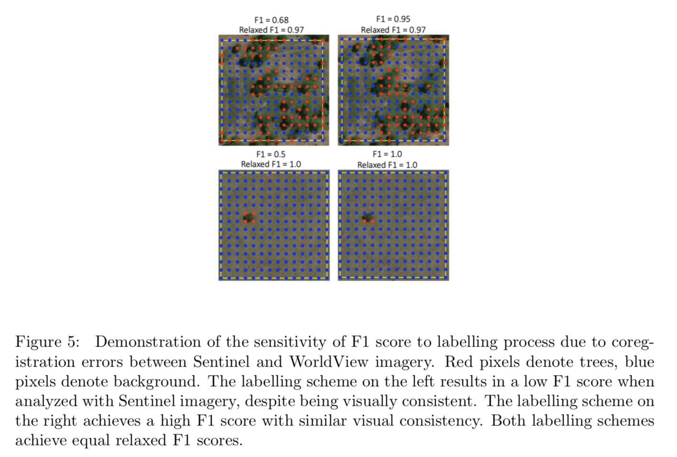

Slide 6
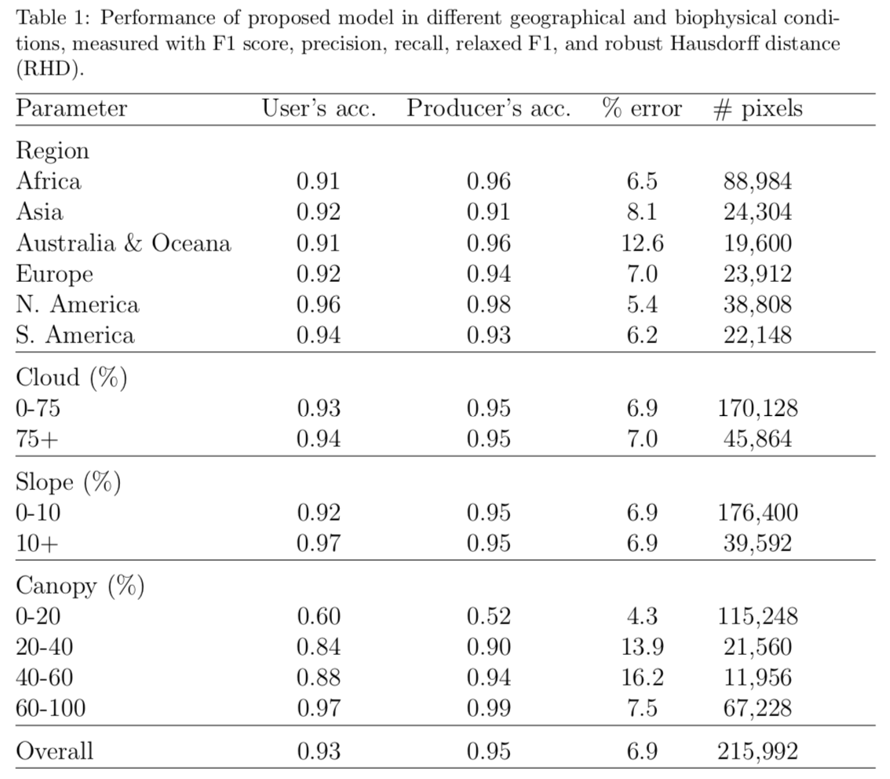

Slide 7
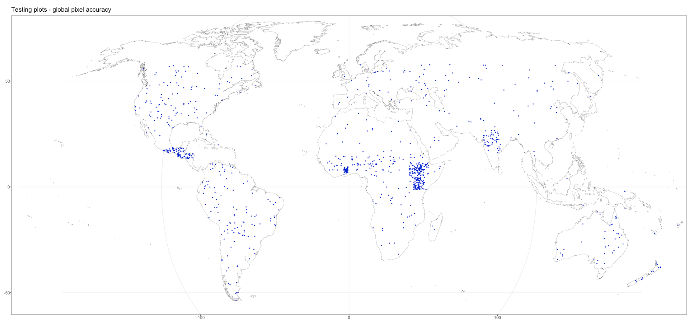
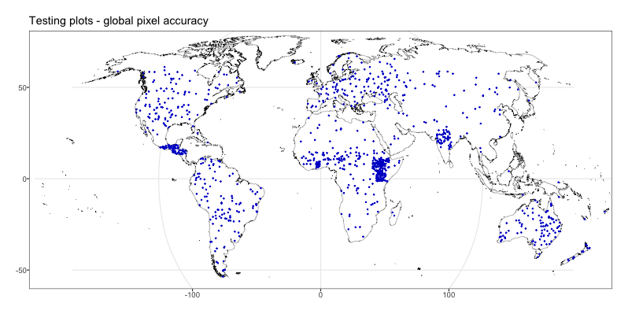

Slide 8
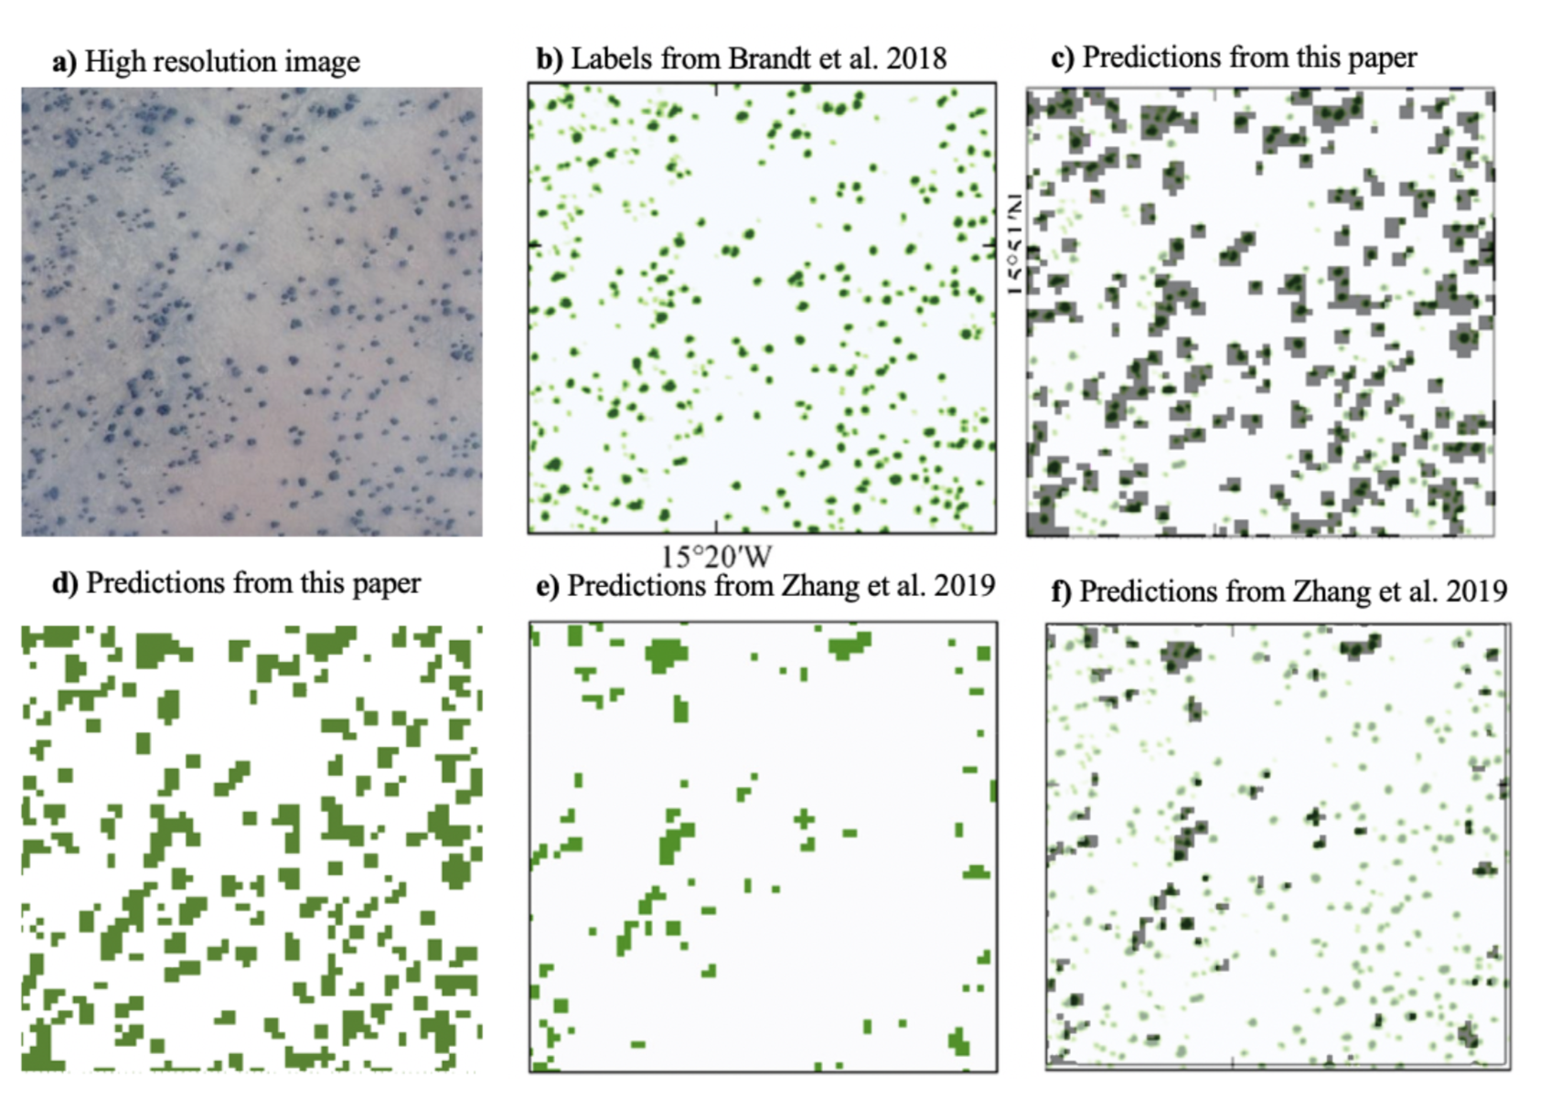

Slide 9
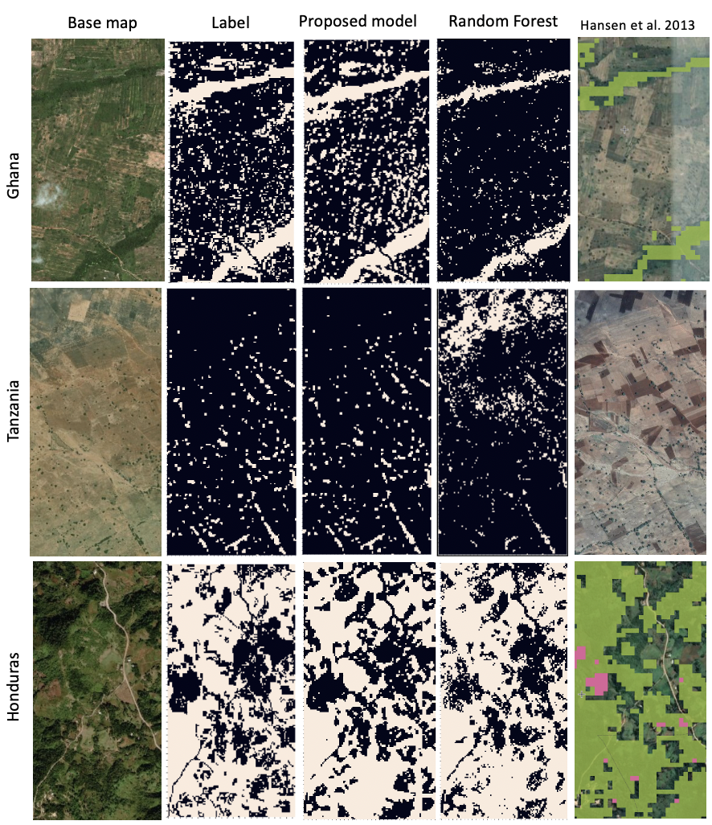

Slide 10
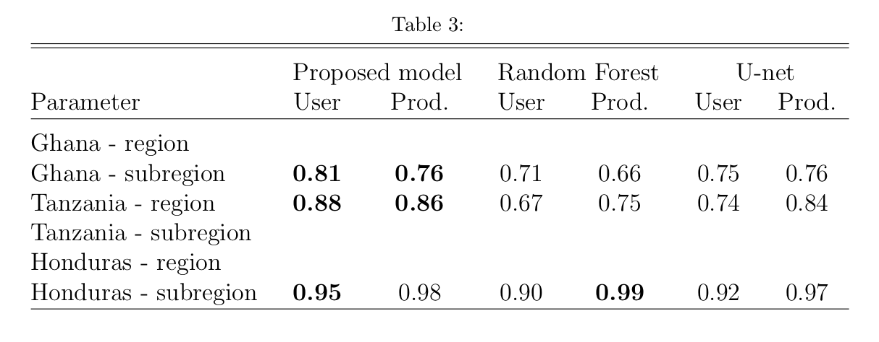
280/810 plots left to label

Slide 11
To do list
Finish regional validation section
Finalize comparisons with Bastin
Rewrite results section
Write discussion section
Create a python script to recreate all results
Submit paper
Hold a brownbag
Landscape engagement

Slide 12
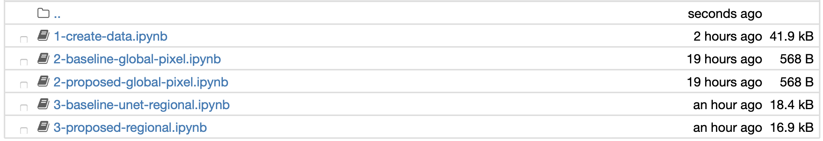

Slide 13
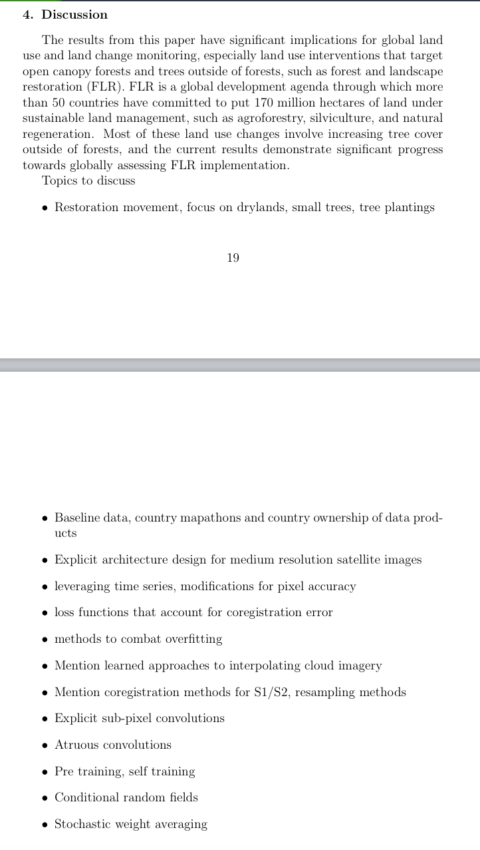

Slide 14
Research management X
3 – advise AI projects across WRI, review with X publications in s&r review
4 – work with IOs to provide advice and expertise in AI projects
5 – standardize AI project design across WRI through data lab, github, IOs – API manager CTO
Landscape impact (how to measure? Quality > Quantity)
3 – 1 landscape
4 – 2 landscapes
5 – 3+ landscapes
Mainstreaming innovations X
3 – Research projects used to fulfill other grants and deliverables
4 – Research projects used by IOs (india, Kenya, brazil)
5 – Research projects used to make other outputs (land use maps) for landscape stakeholders
Teamwork (wordsmith 5) X
3 - Regularly convene with >= 3 landscapes or projects to involve team members in research projects
4 - Work with team members to develop research projects into useable tools
5 – Significantly involve other team members in design and implementation of research projects
Publications – X (Restoration Mapper, Rod/Crystal, BBB2 Blog, GDELT)
3 – Publication and blog post
4 – Three publications or blog posts
5 – Three publications or blog posts, at least one in a high impact journal

Slide 15
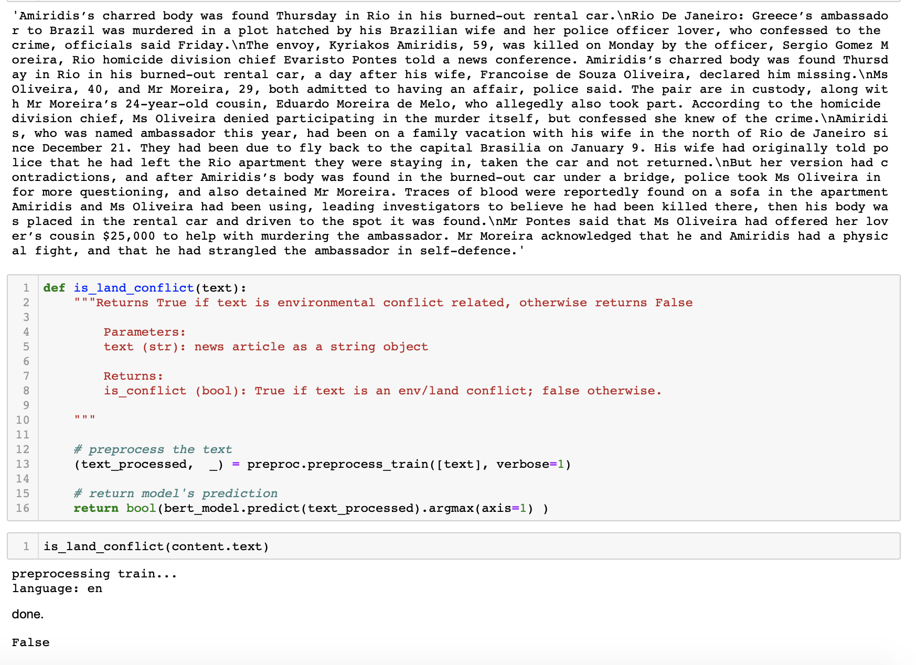

Slide 16
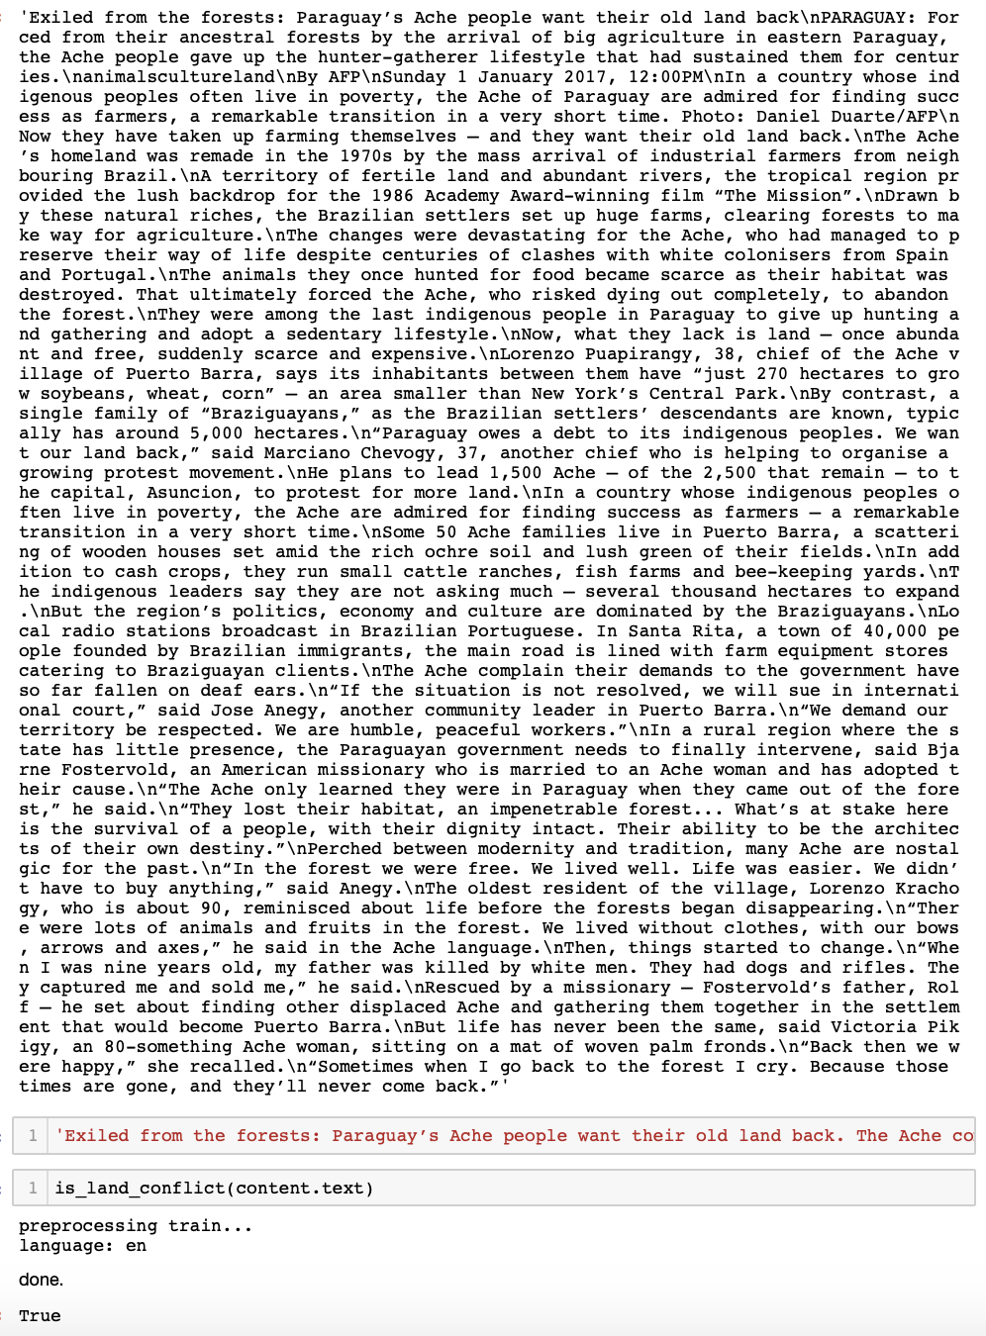

Slide 17
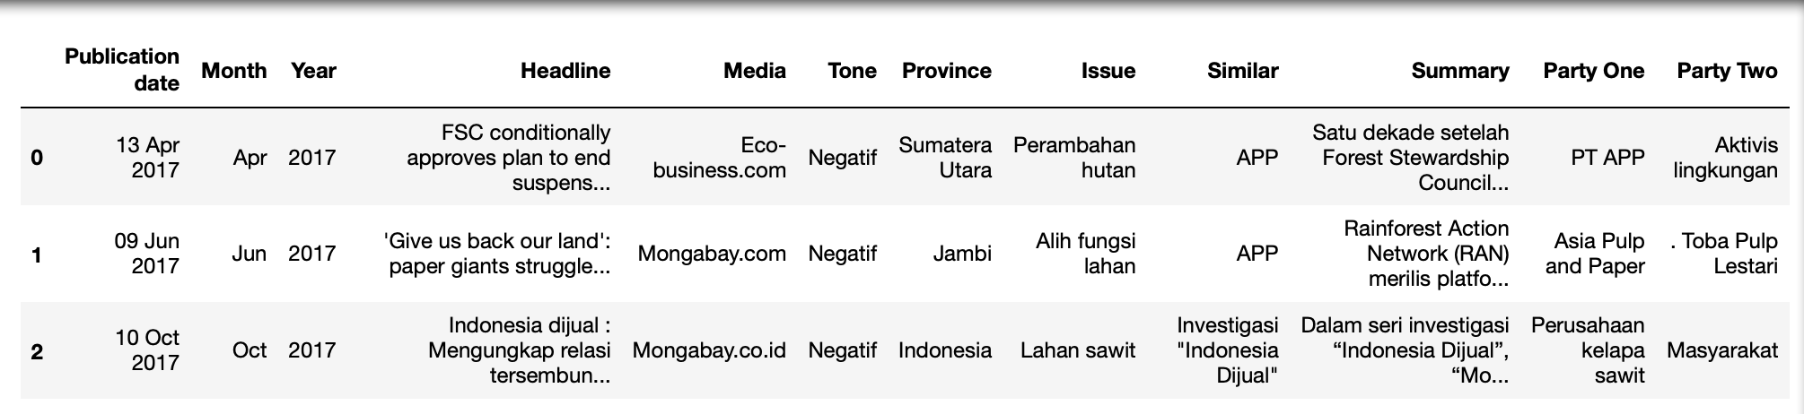

Slide 18
